Slide 1

Sophomore SL/HL Seminar 2023
Mrs. Striblen
IB Coordinator, Assistant Principal
striblene@pcsb.org
Mrs. Shepherd-Thompson
IB Counselor
shepherda@pcsb.org

Slide 2

Benefits of being an IB graduate
Significantly greater likelihood of using a range of critical-thinking skills
Students felt prepared for university coursework involving research; intended to conduct future research; and found that their research skills to be important to future success;
Students developed an ethic of service; became more caring, open-minded, and reflective; and developed more self-confidence and maturity
DP students scored higher on 9 out of 10 items that tested their knowledge of US government structure, functioning and history.
IB Diploma=Full Bright Futures Scholarship

Slide 3
The Diploma Years
Prepares you for…
84.6% of DP candidates globally enrolled in university immediately after high school compared to the national average of 66% --99% at PHUHS IB (85% PHUHS IB attend a Florida College)
A greater percentage of DP candidates enrolled in more selective institutions
90.4% of DP candidates who enrolled in a four-year postsecondary institution immediately after high school were enrolled in the same institution the following year
Our students are persistent, prepared, and proficient!
66.5% graduated within 4 years compared to the national average of 41.4%

Slide 4
College Data from the Florida Association of IB Schools:
Preliminary results of an ongoing initial survey of over 2,000 IB students in the state of Florida shows IB student acceptance rates continue to outpace the overall acceptance rates
University | IB Student Acceptance | Overall Acceptance
University of Florida | 59% | 30%
Florida State University | 78% | 37%
University of Central Florida | 90% | 36%
Princeton | 5% | 4%
Brown | 11% | 6%
University of California, Berkley | 34% | 15%
University of California, Los Angeles | 27% | 11%
New York University | 20% | 13%
University of Michigan | 40% | 20%
Duke | 12% | 6%
University of Pennsylvania | 10% | 6%
Yale | 8% | 5%
University of Virginia | 35% | 21%
Notes:
Striblen

Slide 5
IB Courses ARE College Courses
Earn college credits and/or place into more challenging classes in college for every IB course passed with a 4-7
*Dependent on University’s eligibility requirements
For Florida colleges, students can earn up to 45 college credits (1 ½ years) with the completion of the IB Diploma

Slide 6
What does SL and HL mean?
Content Classes are defined as SL or HL and are two year courses
  SL=Standard Level
  HL=Higher Level
    Typically, Higher Level courses’ content covers a wider breadth of content, goes deeper into the content topics, and requires further assessment requirements
  All SL and HL courses are two year courses
    Exception is SL History (one year)

Slide 7





How many HL and SL classes do I take?
IB requires
3 HL and 3 SL courses

Slide 8
How do I earn my IB Diploma?
Each course is out of 7 points (determined by IB exams)
  earn 12 points in HL Courses
  earn 9 points in SL Courses
  earn 24 points overall
Complete CAS (learning outcomes and project)
Complete Extended Essay

Slide 9
Give out the course request form or put on screen
Let them know they get 2 diploma support classes

Slide 10
What do we call assessments or exams in IB?
Internal Assessments (IAs)
Completed with the teacher, during the course, both in and outside of class
Research related
Called Individual Oral (IOs) in Literature and World Language because these are presented 1:1 with the teacher orally
External Assessments
Completed at the end of the course in May
Consist of short answer, multiple choice, and essays
Called Papers (Paper 1, 2, and/or 3)

Slide 11
Extended Essay
Theory of Knowledge
CAS
Group 1
Studies in Language and Literature
Language A Literature
HL/SL
Group 2
Language Acquisition
French B HL/SL
Spanish B HL/SL
Group 3
Individuals & Societies
History HL/SL***
Psychology HL/SL*
Group 4
Experimental Sciences
Biology HL/SL
Chemistry HL/SL
Physics HL/SL
Sports Exercise Science SL**
Group 5
Mathematics
Applications & Interpretations HL/SL
Analysis & Approaches HL/SL
Group 6
Arts & Electives
Film SL**
Music HL/SL
Theatre Arts HL/SL
Visual Arts HL/SL
Psychology HL/SL
Sports Exercise Science SL**
*Course considered a group 6 elective
**Only offered in Senior year as a 1 year course for students who took SL History
***SL is a one year course for this subject

Slide 12

Group 1
Language A

Slide 13
IB Language A: Literature
Scoring Breakdown Standard Level
Internal Assessment
Individual Oral (30%)
One global issue as addressed by one native work and one work in translation
15 minute oral presentation
External Assessment: Exams
Paper One: Guided Literary Analysis (35%)
Paper Two: Comparative Essay (35%)

Slide 14
IB Language A: Literature
Scoring Breakdown Higher Level
Internal Assessment
Individual Oral (20%)
One global issue as addressed by one native work and one work in translation
15 minute oral presentation
External Assessments
Higher Level Essay (20%)
Exam - Paper One: Guided Literary Analysis (35%)
Exam - Paper Two: Comparative Essay (25%)

Slide 15
Group 2: Language B
(HL vs SL)
French & Spanish

Slide 16

Seal of Biliteracy
ALL IB students are on the path to achieving the gold seal of biliteracy through IB World Language if they complete their 4 years of IB World Language with a 3.0 or higher!

Slide 17
Language B (HL vs SL) - Assessment Component Weighting
5 themes (Identities, Experiences, Human Ingenuity, Social Organization and Sharing the planet)
HL -External assessment (3 hrs 30 min) (75%)
SL -External assessment (3 hrs) (75%)
Paper 1 (1 hour 30 minutes) (25%)
One writing task of 450–600 words from a choice of three, each from a different theme
Paper 2 (2 hours) (50%)
Listening comprehension (1 hour) (25 marks)
Reading comprehension (1 hour) (40 marks)- Comprehension exercises on three audio passages and three written texts (1 literature text)
Paper 1 (1 hour 15 minutes) (25%)
One writing task of 250–400 words from a choice of three, each from a different theme
Paper 2 (1 hour 45 minutes) (50%)
Listening comprehension (45 minutes) (25 marks)
Reading comprehension (1 hour) (40 marks) - Comprehension exercises on three audio passages and three written texts

Slide 18
Language B (HL vs SL) - Assessment component Weighting
5 themes (Identities, Experiences, Human ingenuity, Social organization and Sharing the planet)
HL -Internal assessment (25%)
SL -Internal assessment (25%)
Individual oral assessment (25%)
A conversation with the teacher, based on an extract from one of the literary works studied in class, followed by discussion based on one or more of the themes from the syllabus.
Individual oral assessment (25%)
A conversation with the teacher, based on a visual stimulus on a theme (Identities, Experiences, Human ingenuity, Social organization and Sharing the planet) , followed by discussion based on an additional theme.

Slide 19
Language B Curriculum Considerations
HL has a strong focus on Literature.
HL Students read two novels together in target language.

Slide 20
Group 3
Individuals & Society
(History & Psychology)
*Psychology is considered as an elective and a Group 6 course

Slide 21
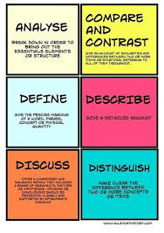
SL History (Only One Year)
Paper 1 - We will choose one of the following prescribed subjects: 1. Conquest and its Impact 2. The Move to Global War or 3. Conflict and Intervention
Internal Assessment (IA): Historical Research Paper.
Paper 2 -Twelve Topics to choose from (student choice)
Due Dates: IA – December Paper 1 and Paper 2 Exam - May

Slide 22
HL History
HL-First Year Course
Contemporary History 19th-21st Century Topics Could Include:
  Rights & Protest: Civil Rights in the US, 1956-65, Apartheid in South Africa, 1948-64
  Authoritarian States: Castro (Cuba), Nasser (Egypt), Hitler (Germany), Mao (China)
  Independence Movements (1800-2000): Cuba, Zimbabwe, India & Pakistan, Vietnam, Ireland
Paper 1 and Paper 2 Exams (externally scored)
Internal Assessment
HL-Secondary Year Course
Contemporary History AND
History of the Americas 19th - 20th Century Topics Could Include:
  Political developments in Latin America (1945-1980)
  The Cold War and the Americas (1945-1981)
  Civil rights and social movements in the American post-1945
Paper 1, 2, and 3 (19th –20th Century Topics) (externally scored)
Internal Assessment
*There are 20 topics within the curriculum to choose from; topics are subject to change.

Slide 23
Senior Level
One Year
IB Courses following completion of
SL History
If SL History is completed in Junior year, students can take an additional elective
Film Studies
Sports Exercise Science
University Elective

Slide 24
Group 4
Science

Slide 25
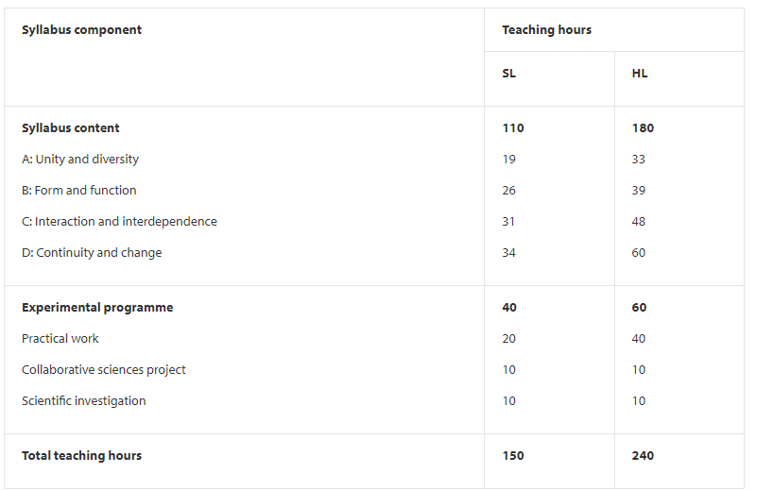
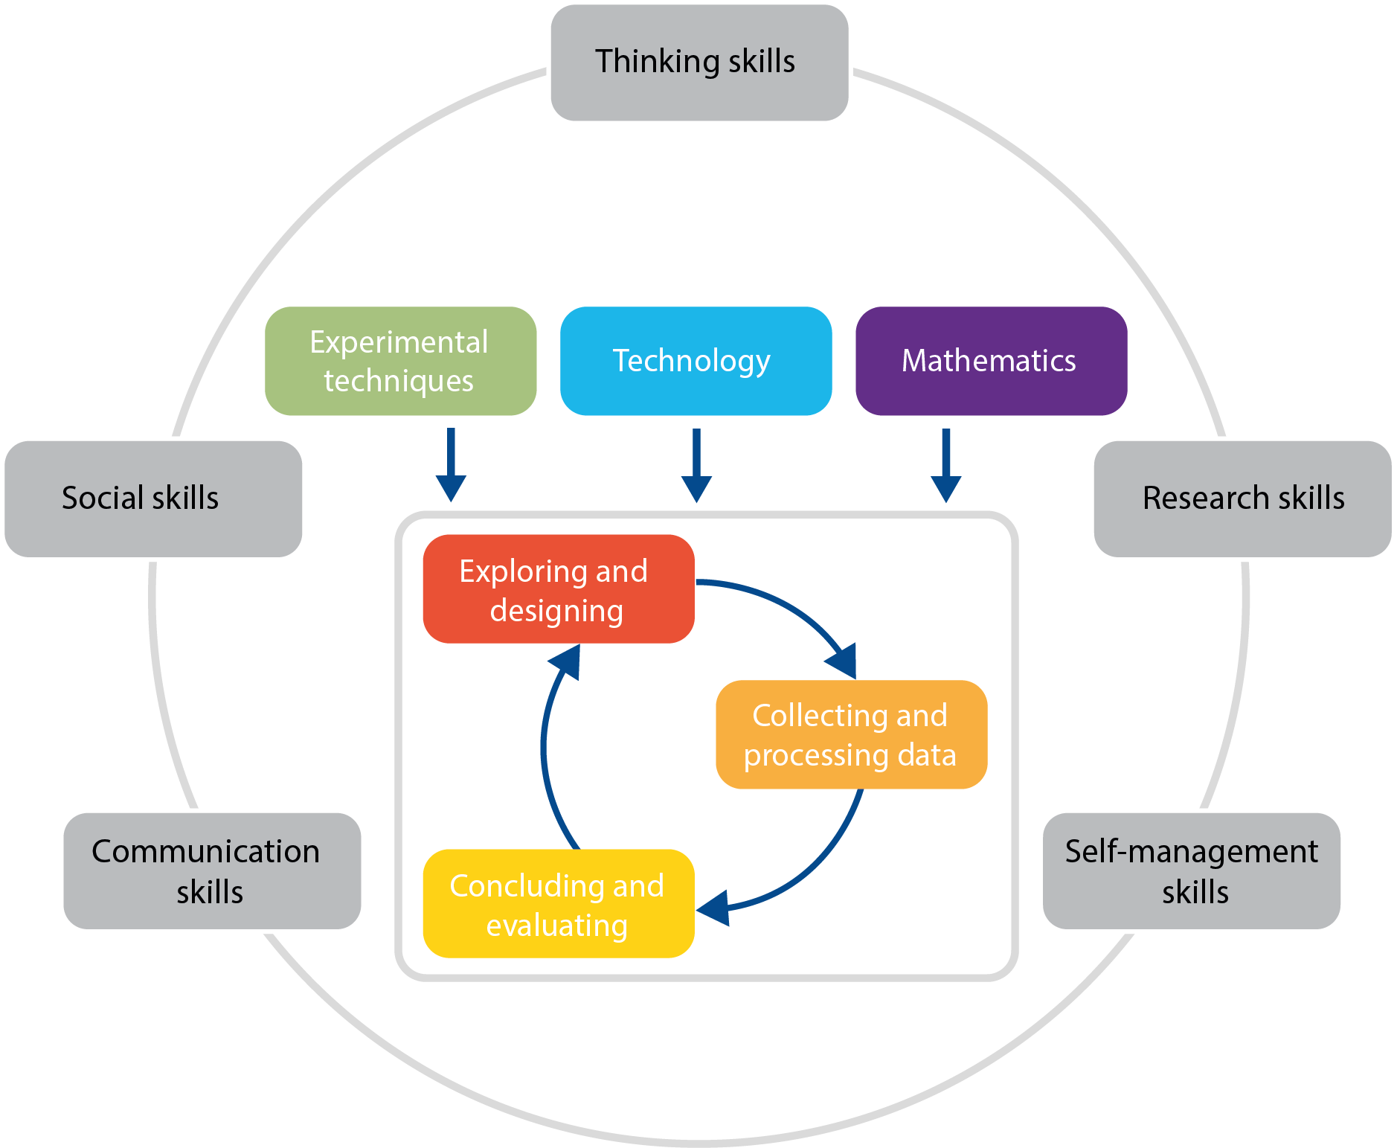
Biology

Slide 26
Why take IB Chemistry?
You love chemistry and want to challenge yourself in more advanced topics!
You are planning on a STEM major in college!
You want to get a leg up on your college classmates with some organic chemistry knowledge!

Slide 27
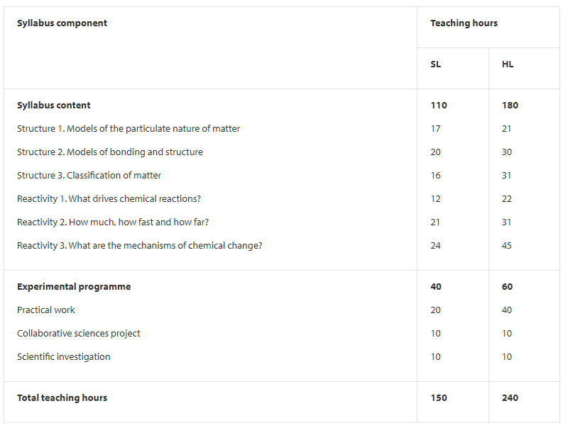
Chemistry

Slide 28
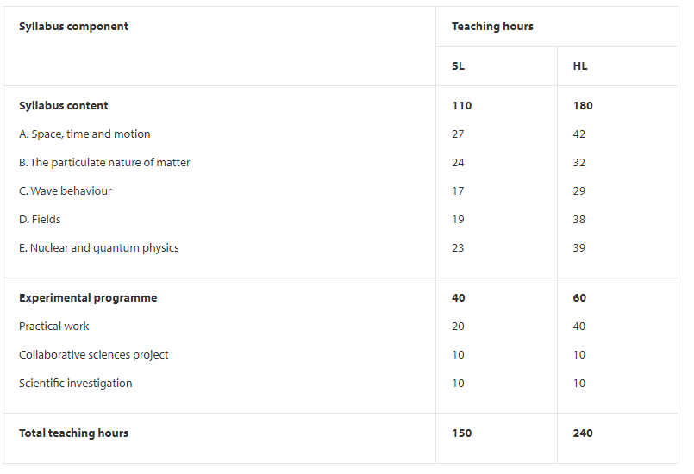
Physics

Slide 29
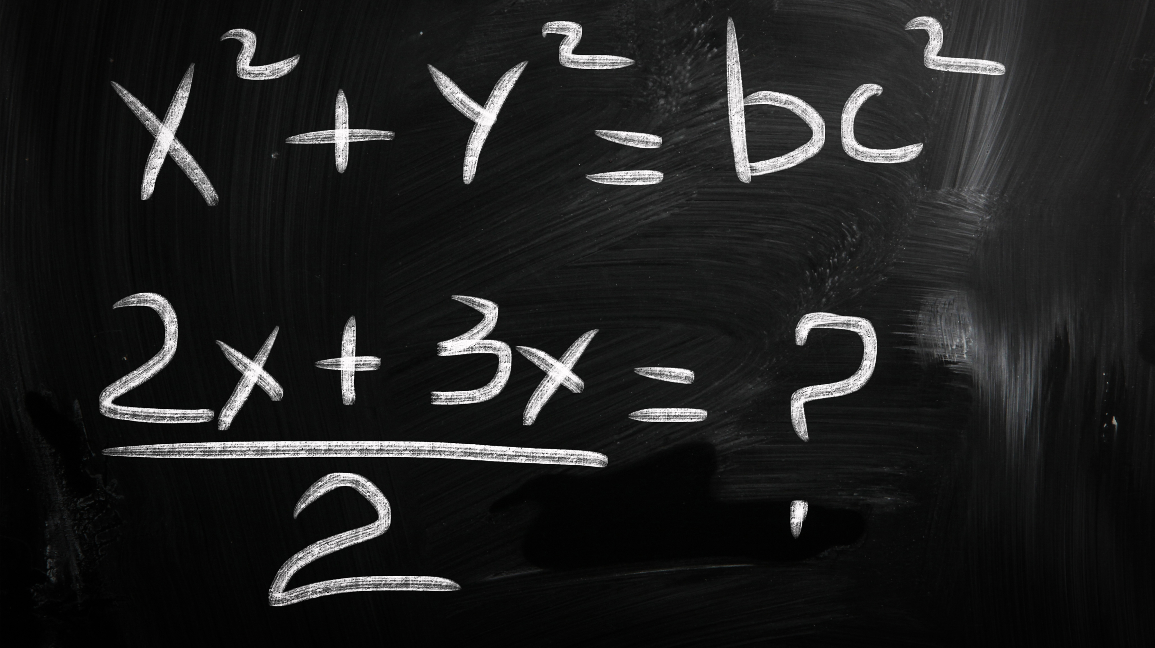
Group 5
Mathematics
This Photo by Unknown author is licensed under CC BY-SA-NC.

Slide 30
Mathematics
Applications & Interpretations SL/HL
11th grade Applications 1 or AP Calculus (HL)
12th grade Applications 2 or 3 (HL)
Analysis & Approaches
SL/HL
11th grade AP Calculus AB or BC (HL)
12th grade Analysis 2 or Analysis 3 (HL)
Five Topics Covered in all courses at varying levels.

Slide 31
Mathematics SL Testing
Both Classes cover 150 hours approximately 45 standard
Applications & Interpretations- Calculator Used on all Papers
Analysis & Approaches-Calculator Used on Paper 2 only
Paper 1 (90 minutes) 40%
80 marks-Compulsory short response questions
Paper 2 (90 minutes) 40%
80 marks- Compulsory extended-response questions
Mathematical Exploration (20 marks) 20%
This is a piece of written work that involves
Investigating an area of mathematics.

Slide 32
Mathematics HL Testing
Both Classes cover 240 hours approximately 78 standard
Applications & Interpretations- Calculator Used on all Papers
Analysis & Approaches-Calculator Used on Paper 2 and Paper 3
Paper 1 (120 minutes) 30%
110 marks-Short response questions
Paper 2 (120 minutes) 30%
110 marks-Extended-response questions
Paper 3 (60 minutes) 20%
55 marks
Two extended response problem solving questions
IA-Mathematical Exploration (20 marks) 20%

Slide 33
Mathematics Analysis & Approaches
The same five topics (Number and Algebra, functions, Geometry/Trigonometry, Probability and Statistics, Calculus) are covered during the SL and HL courses. Each topic has sub-topics. HL students cover some additional sub-topics or the same sub-topics at greater depth.
Additional topics include:
  involved proofs,
  implicit differentiation & related rates,
  Partial fractions,
  displacement vectors, scalar & vector product, vector equations of lines,
  Proofs of geometrical properties using vectors
  derivatives of exponential & logarithmic functions,
  complex numbers to understand periodic models,
  De Moivre's Theorem

Slide 34
Mathematics Applications & Interpretations
The same five topics(Number and Algebra, functions, Geometry & Trigonometry, Probability and Statistics, Calculus) are covered during the SL and HL courses.
  Each of these topics has sub-topics with HL students covering some additional sub-topics or the same sub-topics at greater depth.
Additional topics include:
  Inverse variation models,
  displacement vectors, scalar and vector product, vector equations of lines,
  logistic models, sinusoidal models, complex numbers to understand periodic models,
  matrices,
  eigenvalues, eigenvectors,
  slope fields,
  differential equations, and
  graph theory.

Slide 35
Applications and Interpretations | Analysis and Approaches
IB recognizes the increasing role that mathematics and technology play in a diverse range of fields in a data rich world. The focus is on topics that are often used as applications or in mathematical modelling. Students use the graphing calculator more often to solve the problems. This course is for students who enjoy solving practical problems using mathematics, those who enjoy harnessing the power of technology as exploring the more practical side of mathematics. | IB recognizes the need for analytical expertise in a world where innovation is increasingly dependent on a deep understanding of mathematics. The focus is on developing important mathematical concepts in a coherent and rigorous way. Students construct, communicate, and justify correct mathematical arguments. This course is for students who enjoy algebraic calculations, investigation, proofs, and some graphing calculator skills. Fewer contextual questions. More working steps.

Slide 36
Group 6
Fine or Performing Arts
Psychology
Sports Science

Slide 37

Benefits to IB Art
The IB curriculum is meant to create well-rounded students. Completing a course in all 6 subjects accomplishes this goal.
The work is much different than the academic classes, therefore giving students variety in their day, their workload, and their education in general.
Colleges are looking for students with a range of experiences and long-term commitment to endeavors beyond academics.
IB Art is a fun course that allows you to explore your creativity.
Requirements
Students must take 2D or 3D studio Art as a prerequisite.
Things to Know:
Art does take a lot of time, effort and dedication. There is no version of “cramming” for an art project.
Work submitted for exams includes final artworks, sketchbook work, an art history assignment, and an exhibition. All work is graded according to the IB rubric which includes:
Technical competence with media
Research on various artists
Conceptual qualities are required
Reflective writing on your process
Questions? Email Ms. Swisher- swishera@pcsb.org
Please stop by the art room at any time to see examples of
IB student artwork and to meet Ms. Swisher.
If you really want to see what IB art is like, stop by during 6th or 7th period!

Slide 38
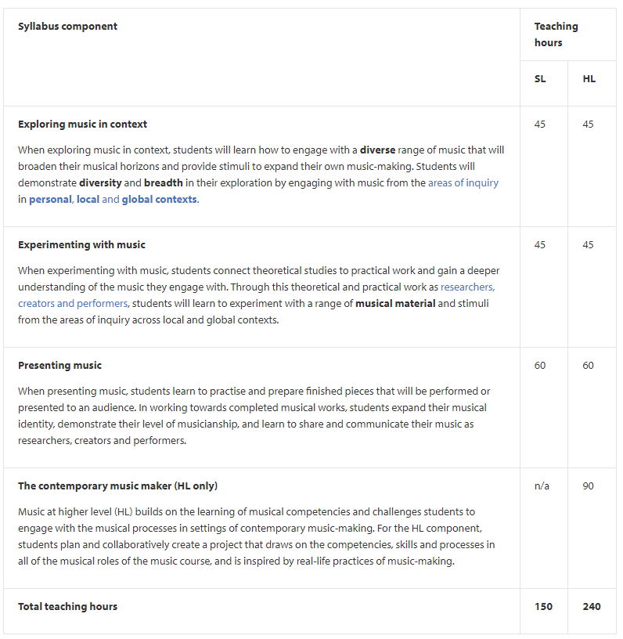
The greater breadth and depth required for HL is reflected through an additional assessment task. This task requires HL students to demonstrate knowledge and understanding of the core syllabus areas by formulating and communicating intentions for a project that is based on:
real-life practices of music-making
their experiences as developing musicians in this course their collaboration with others.

Slide 39

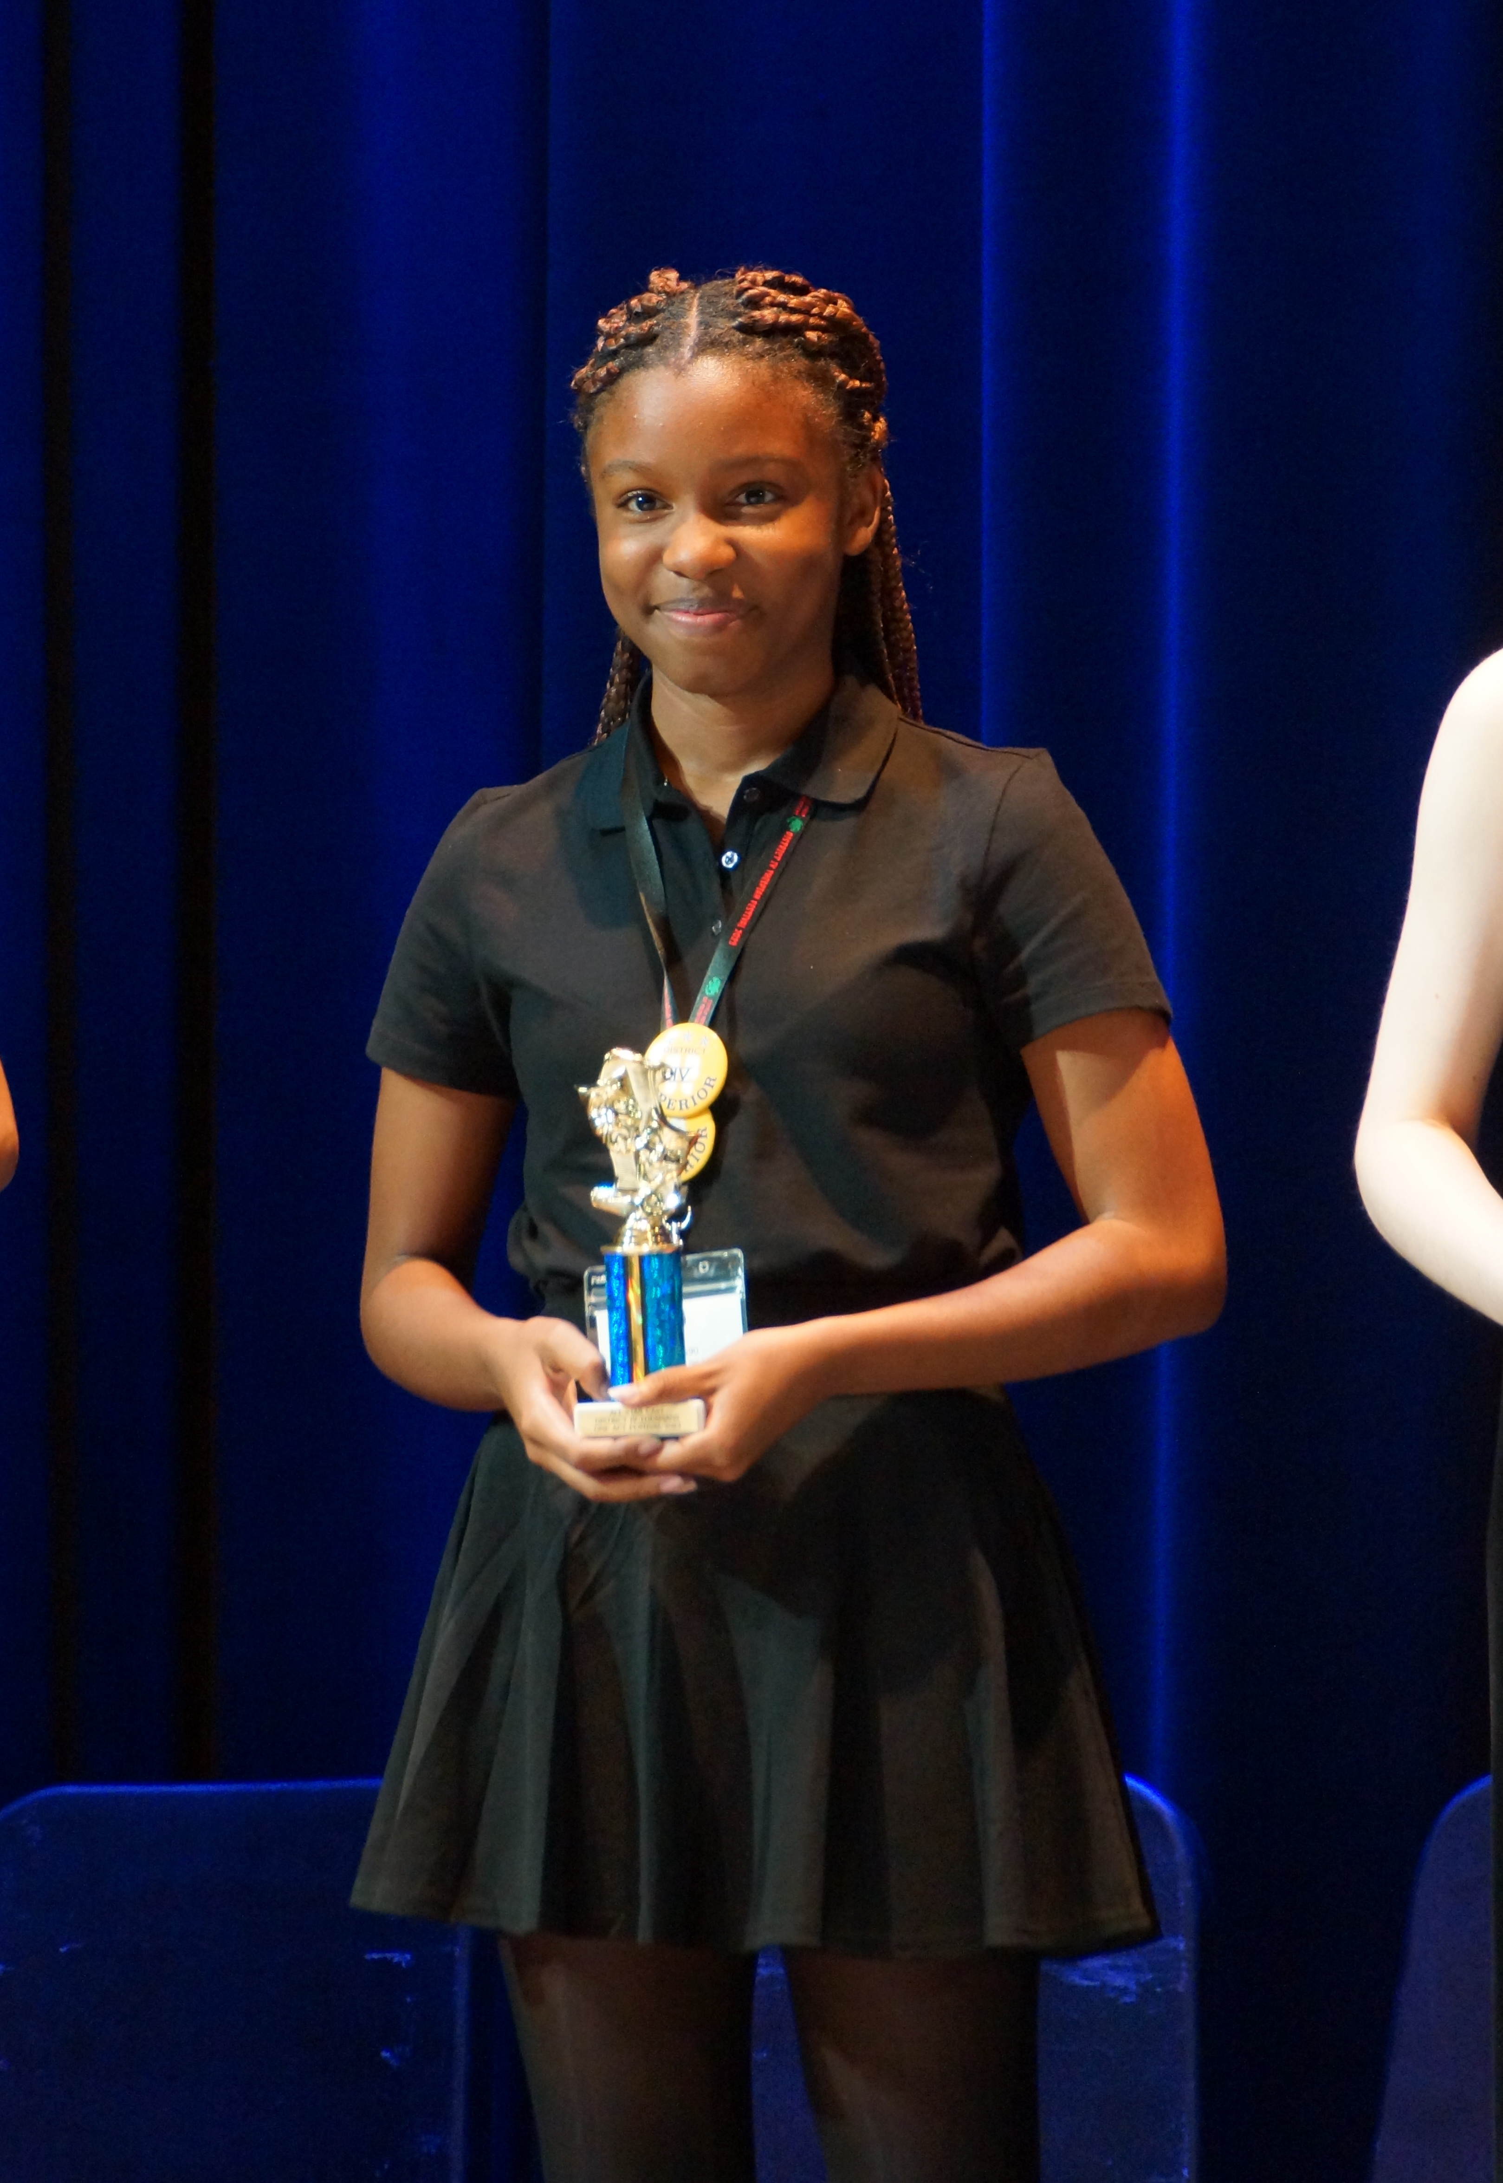
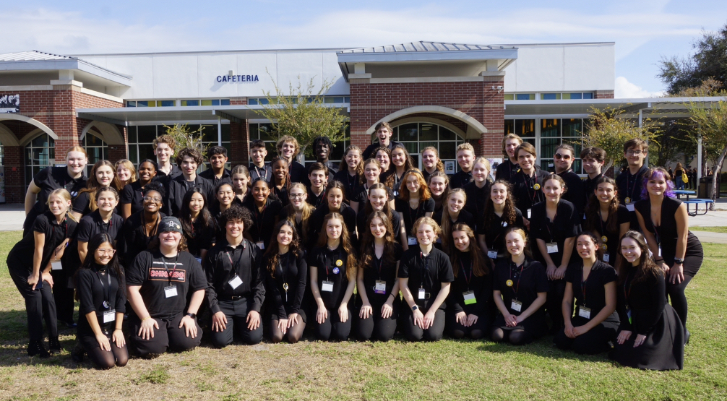
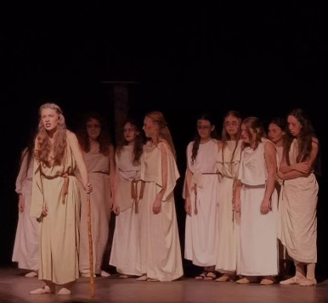
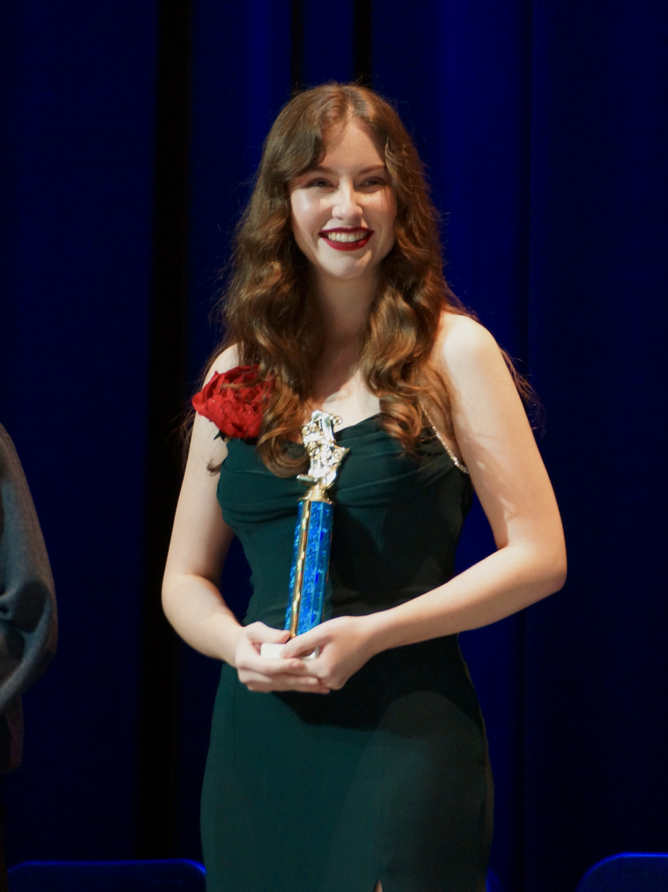
HL & SL THEATRE COURSES
Theatre is a practical subject that encourages discovery through experimentation, the taking of risks and the presentation of ideas to others. It results in the development of both theatre and life skills; the building of confidence, creativity and working collaboratively.
The IB Diploma Programme theatre course is a multifaceted theatre-making course of study. It gives students the opportunity to make theatre as creators, designers, directors and performers.
The theatre course encourages students to appreciate that through the processes of researching, creating, preparing, presenting and critically reflecting on theatre— as participants and audience members—they gain a richer understanding of themselves, their community and the world.
ASSESSMENTS- NO EXAM!
1) Production Proposal –Portfolio (Former DN) (SL 30% / HL 20%)
2) Research Presentation-Presentation (World Tradition of Theatre)
(RP) (SL 30% / HL 20%)
3) Collaborative Project-Group Project-(Devising Theatre) (SL 40% / HL 25%)
4) Solo Theatre Piece-Individual Performance (HL only 35%)
District Thespian Festival, 2023

Slide 40
IB Psychology
Two year course
SL and HL students work together in the same class

Slide 41
IB Psychology-Junior Year
AP Psychology – At a glance
Unit 1 Research Methodology
Unit 2 Sociocultural Approach to Behaviour: Social Influence
Unit 3 Cognitive Approach to Behaviour
Unit 4 Biological Approach to Behaviour
Unit 5 Research Review
Unit 6 Mock Paper 1-3
Unit 7 Introduction to Internal Assessment and Concepts of Research

Slide 42
IB Psychology-Senior year
All HL & SL students do a deep dive into three core approaches to Psychology:
Biological, Cognitive, Sociocultural
Additional approaches include Developmental & Abnormal Psychology.
All HL and SL students participate in a group IA project
Study replication (on campus activity)
All students also study quantitative & qualitative methods of study.

Slide 43
IB Psychology Assessments
HL
SL
Paper I
  Section A (3 essays)
  Section B (1 essay)
Paper II (2 essays)
Paper III
IA (1800-2200 words) – study replication
Paper I
  Section A (3 essays)
  Section B (1 essay)
Paper II (1 essays)
  only one essay for Paper II; no Paper III
IA (1800-2200 words)

Slide 44
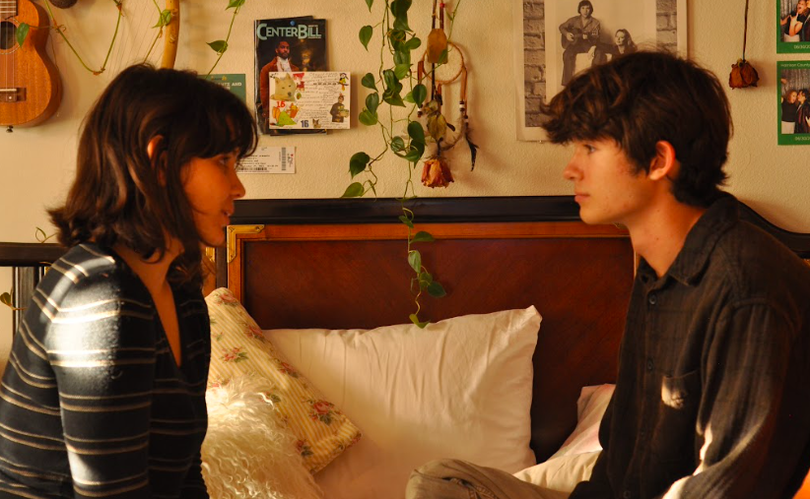
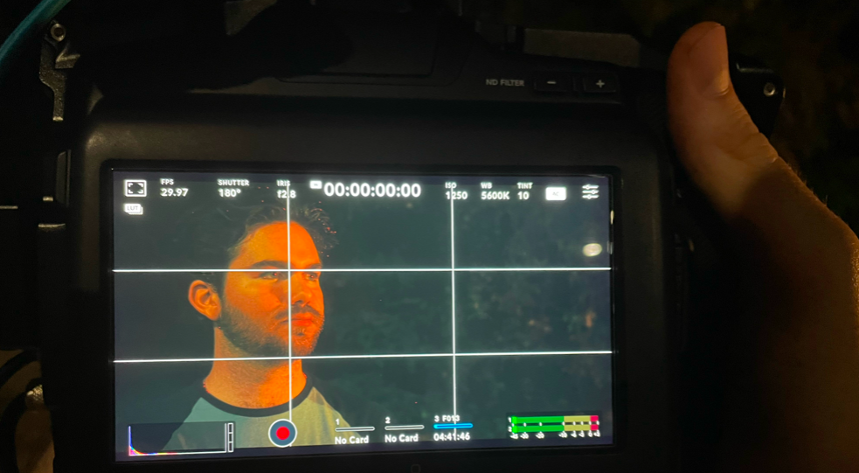


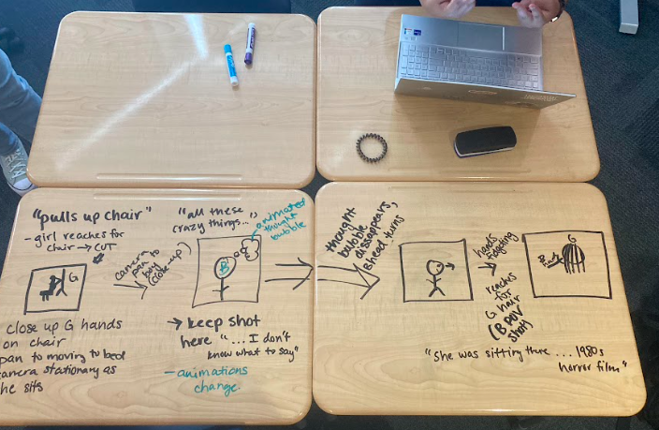
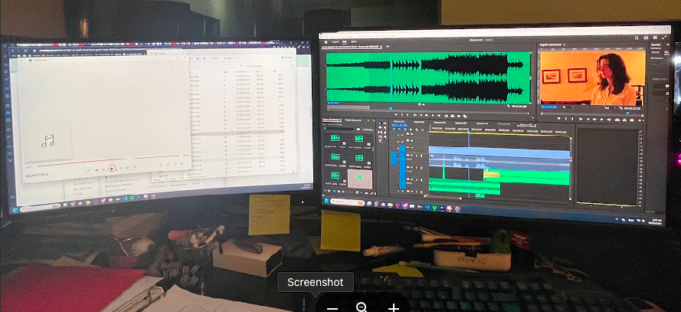
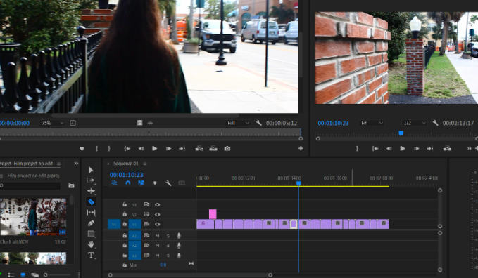
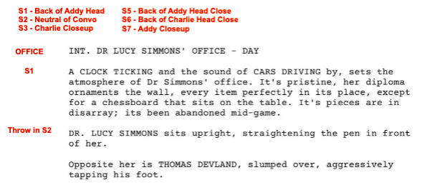
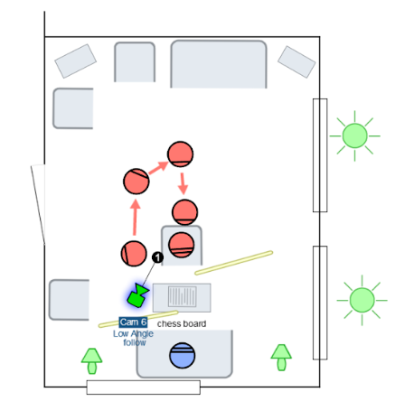
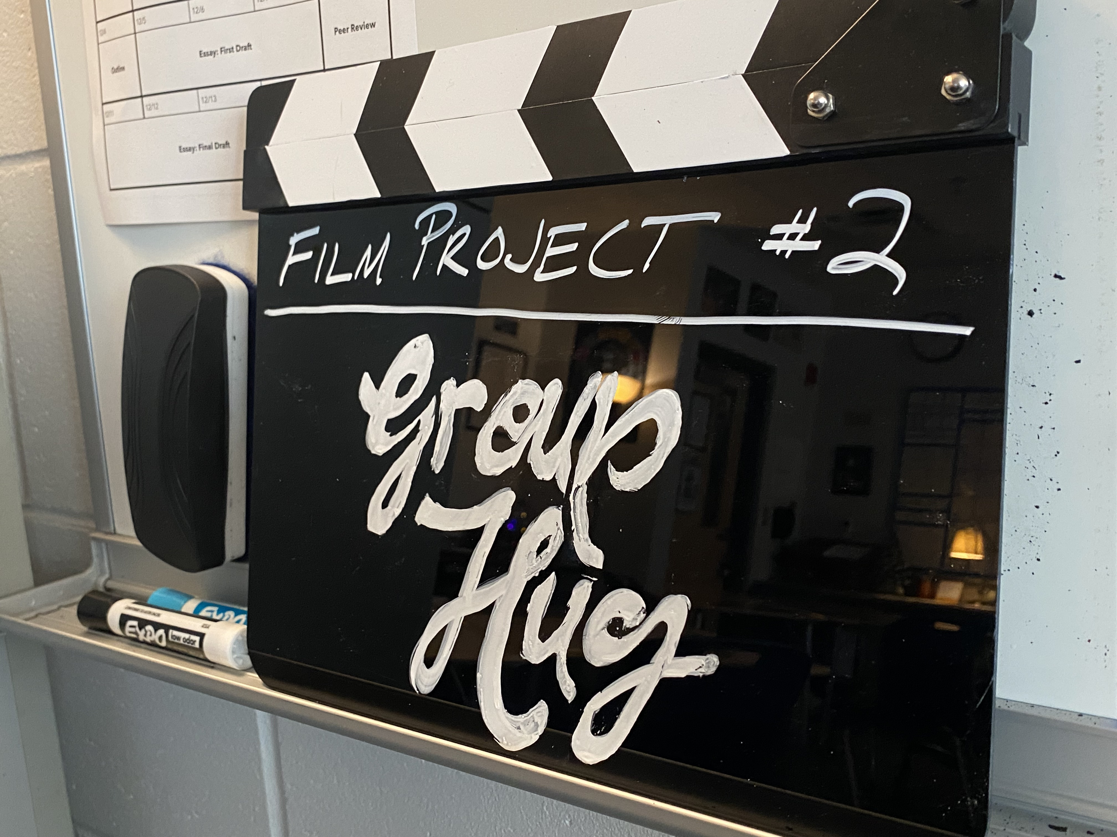
IB Film
Core Syllabus Areas:
  Exploring film production roles
  Reading film
  Contextualizing film

Slide 45


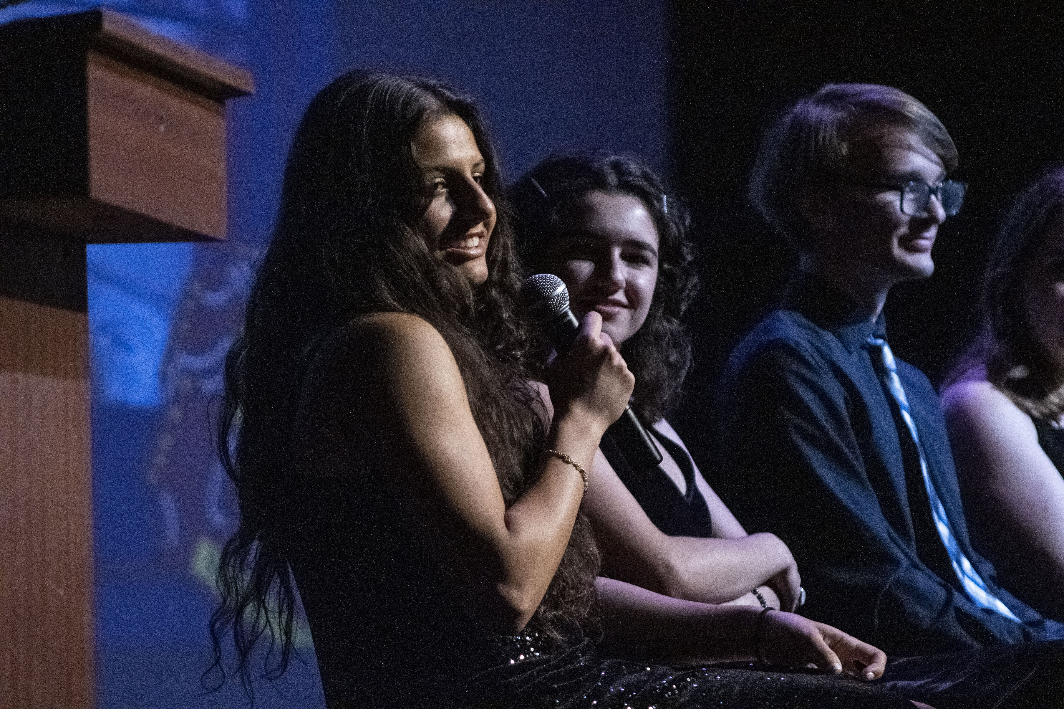
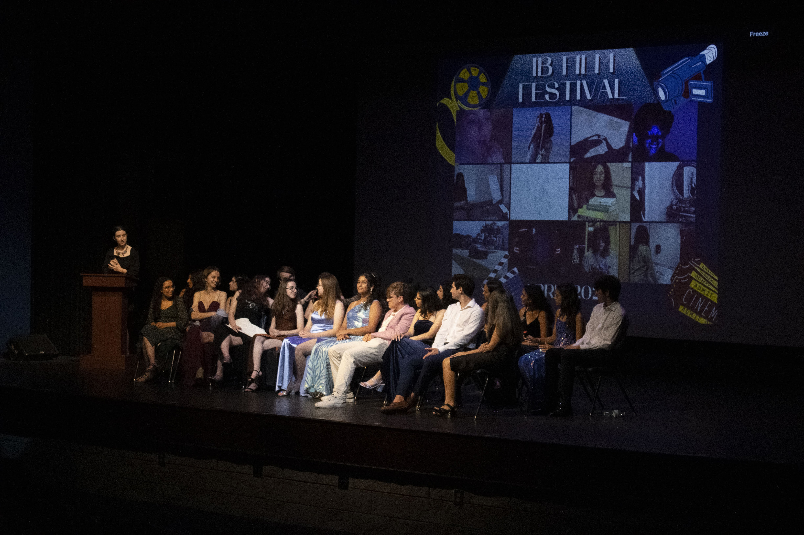
IB Film
Festival

Slide 46

IB Sports Exercise Science
Core:
  Anatomy
  Exercise physiology
  Energy systems
  Movement analysis
  Skill in sports
  Measurement & evaluation of human performance

Slide 47
Everyone needs to take a group 6!

Slide 48
1 year courses vs. 2 year courses

Slide 49

The DP Core
Theory of Knowledge
Extended Essay
CAS

Slide 50
Theory of Knowledge
Required for IB students globally
Essential questions:
How do we know what we know?
Where does our knowledge come from?
Students reflect on the knowledge, beliefs and opinions they have formed over their years of academic studies and their lives outside the classroom.
The course culminates in a TOK exhibition (IA) and TOK essay (external assessment)

Slide 51
The 8 Areas of Knowledge
How we divide up and label the knowledge we possess:
Mathematics
Natural Sciences
History
Knowledge and the Knower
The Arts
Human Sciences
Knowledge and Technology
Indigenous Knowledge Systems

Slide 52
The
Extended Essay
Required for all IB students throughout the world
01
4000 word essay written in one of the student’s subject areas
02
Will have a teacher advisor to guide the student through the process
03
Essay process starts in 2nd semester junior year in TOK
04
Students write the essay over the summer and turn in their first edition in August when school resumes

Slide 53
CAS
Creativity, Activity, Service
Part of the IB Core, required for the IB Diploma and graduation
Strands-
Creativity, Activity, Service
Starts first day of
Junior Year
18 month commitment to your community and to yourself
This summer find a place to provide community service monthly.
Student meeting this spring during AR.
Be on the lookout for the date!

